Slide 1
Posttraumatic growth of children in Tohoku after the earthquake Takehiko Ito (Wako University and JISP) Symposium 27: Voices of Tohoku: A narrative approach to mental health by expression of experience The 5th World Congress of Asian Psychiatry(WCAP2015) 17:10-18:30, March 5, 2015 Room C, Centennial Hall Kyushu University School of Medicine, Fukuoka, Japan

Slide 2
Symposium 27: Voices of Tohoku: A narrative approach to mental health by expression of experience Purpose
Narrative approach in the framework of the individual and community building is an important topic for disaster victims when recovering from stressful experiences and acquiring post-traumatic growth (PTG).
This symposium will discuss the issues and characteristics of facilitating local mental health recovery through an NGO's activities.

Slide 3
Symposium 27: Voices of Tohoku: A narrative approach to mental health by expression of experience Presenters
(1) Mr. Oren (Mr. Polizer)will speak about his NGO activity in the Tohoku area for supporting those with disaster experience (IsraAIDS).
(2) Mr. Oren (Ms. Fukumoto) will introduce the importance of training communities in healing trauma (Healing Japan).
(3) Mr. Ito will discuss the posttraumatic growth seen in Tohoku children (in relation to Voices of Tohoku).
(4) Ms. Inoue will present the plan for a psychosocial support center in Japan (JICTER).

Slide 4
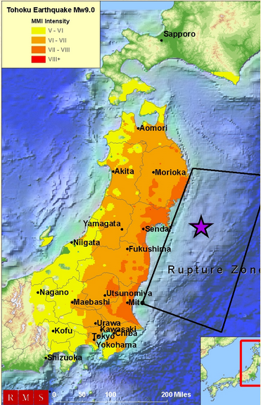

Slide 5
311Earthquake-tsunami-nuclear disaster Casualties and damages (as of June 2011)
The government has confirmed 15,365 deaths, 5,363 injured, and 8,206 people missing across eighteen prefectures (nearly 1/3 of Japan) , as well as over 125,000 buildings damaged or destroyed.
Around 4.4 million households in northeastern Japan were left without electricity and 1.5 million without water.

Slide 6
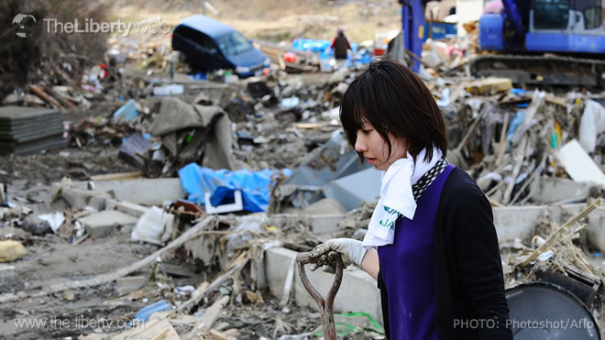

Slide 7
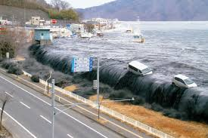

Slide 8
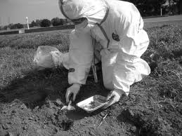

Slide 9
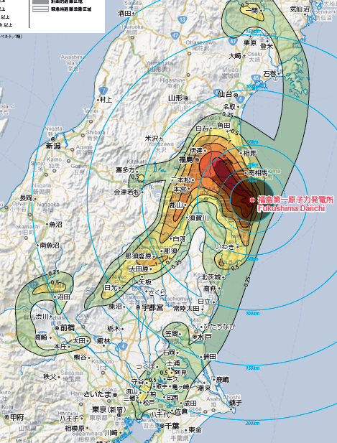
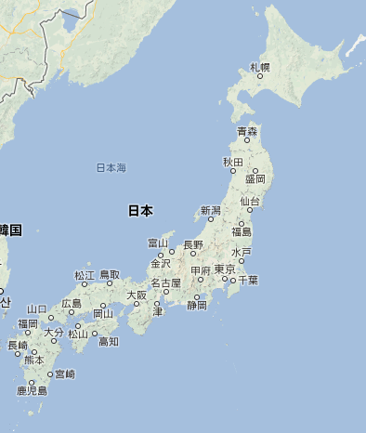
Fukushima
City
Tokyo
Wako Univ.
0.07μSv/h

Slide 10
1. Introduction
The Great East Japan Earthquake, which occurred on March 11, 2011, was a mega-earthquake followed by a large tsunami. The disaster was compounded by nuclear meltdowns at the power plants in Fukushima.
Nuclear Power Plant: this leakage forced many people to evacuate their homes, and the large number of evacuees remain a grave problem.
It is the children affected by this disaster who are the focus of this study. Essays written by children recording their experiences and thoughts about what happened serve as a valuable means for understanding their psychological state and life situation.

Slide 11
Post-Traumatic Growth in Childrens’ Essays after the Disaster
This study examines this issue from the perspective of post-traumatic growth(PTG).
Post-traumatic growth= positive psychological change experienced as a result of the struggle with highly challenging life circumstances.
Tedeschi & Calhoun(1996) found five factors in their Post-Traumatic Growth Inventory.

Slide 12
The Five Factors of PTG （Tedeschi & Calhoun, 1996）
Factor 1 “Relating to Others”
Factor 2 “New Possibilities”
Factor 3 “Personal Strength”
Factor 4 “Spiritual Change”
Factor 5 “Appreciation of Life”

Slide 13
2. Objectives
The purpose of this study was to examine the essays written by children who experienced the Great East Japan Earthquake
in order to clarify the characteristics of these essays.
To explore the possibilities for PTG in accordance with the five factors in the Post-Traumatic Growth Inventory.

Slide 14
3. Method – Four books analyzed
“Tsunami: The Complete Essays by Children from the Disaster Areas”, Ken Mori, 2012 (Bungeishunju); 85 essays.
“Tsunami: 80 Essays by Children from the Disaster Areas” (August Special Issue) (Bungeishunju); 4 essays.
“Children of the Tsunami: The Unwritten Stories”, Ken Mori, 2011 (Bungeishunju); 44 essays.
“I Want to Go Home: Children of Fukushima Thinking about Life, Family, and the Future”, The Fukushima Children‘s Project for the Future, edited by Minoru Kamata, 2012; 36 essays.
The total number of essays analyzed was 161.

Slide 15
The 161 essays were converted into text and then text mined using the text mining software Text Mining Studio version 4.1.
Text mining is a means of carrying out quantitative analysis on qualitative data such as text.
The items of analysis were: basic statistics, word frequency, word network, and correspondence analysis.
Specific attributes of school age (grade), prefecture(Fukushima, Miyagi, Iwate, and Ibaragi), gender, whether damage was caused by the tsunami or the nuclear leakage were analyzed.

Slide 16
Fukushima
City
Tokyo
Wako Univ.
0.07μSv/h

Slide 17
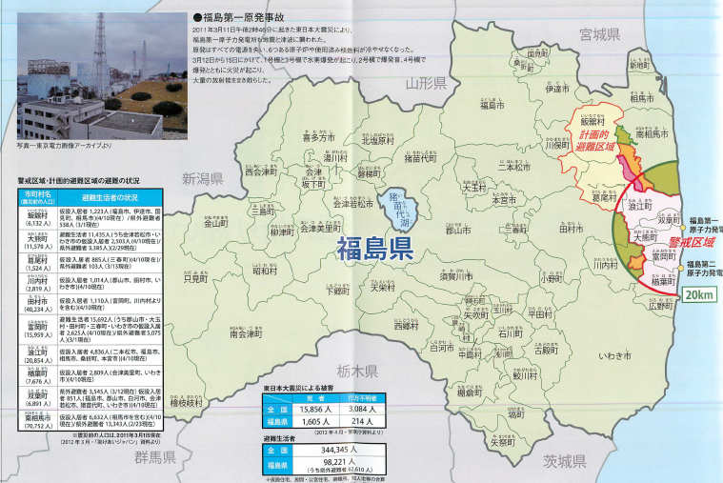
Map of Fukushima Prefecture
Fukushima
City

Slide 18
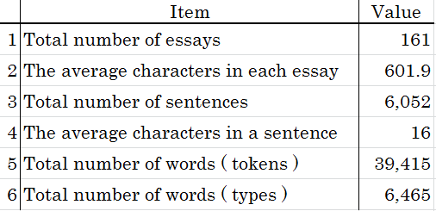
4. Results：Basic information of 161 essays

Slide 19
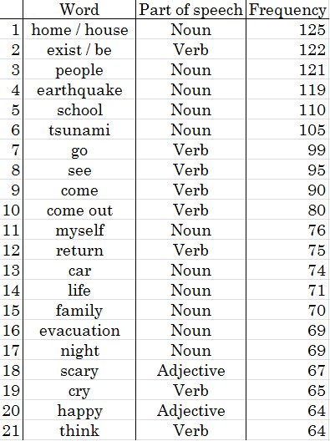
Word frequency (numbers of students, essays)

Slide 20
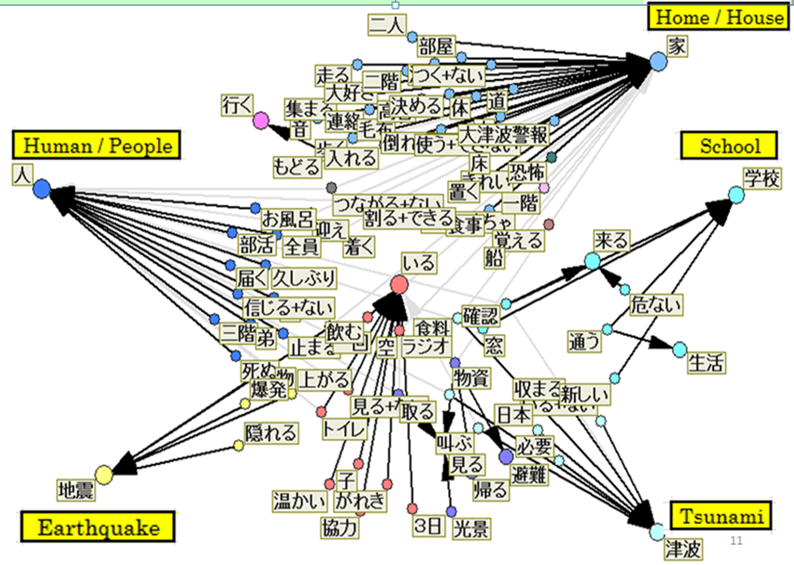
Network Analysis

Slide 21
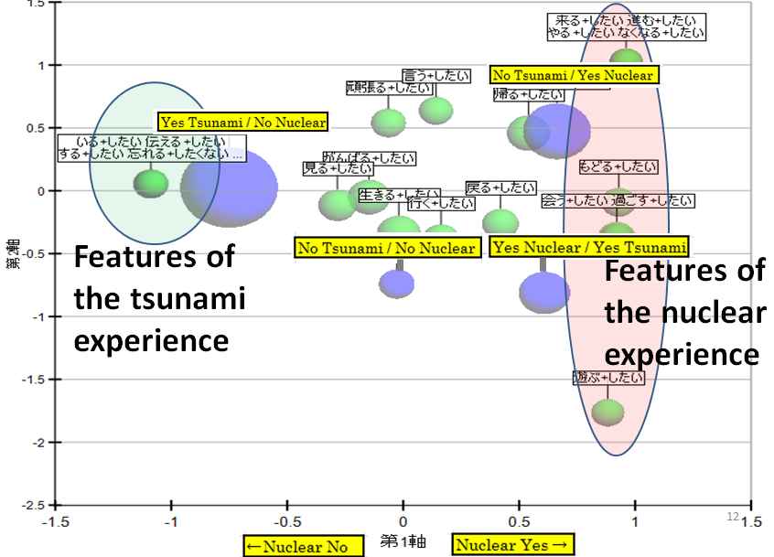
To proceed
To abolish
To say
To do best
To live
To get back
To meet
To live with
To remember
To tell people
What children want to do
To play outside

Slide 22
Factors of Post-Traumatic Growth
Factor 1: “Relating to Others”
Factor 2: “New Possibilities”
Factor 3: “Personal Strength”
Factor 4: “Spiritual Change”
Factor 5: “Appreciation of Life”

Slide 23
Factor 1: “Relating to Others” （１）“Relations with family”
Many people lost family members and friends in the earthquake.
A boy who lost his grandfather said: "I realized the depth of family ties in the earthquake."
A female junior high school student who gave up her portion of food rations so her pregnant mother and brother could eat when food rations were delayed said: "I gave my food to my Mum and brother who needed more."

Slide 24
Factor 1: “Relating to Others” （２） “Relations with strangers”
Altruistic behavior
A junior high school boy described the following: "Drinking water was a problem in the shelter. Despite the fact that the Self-Defense Forces delivered water, there still was not enough. So we all worked together to collect rain water which we then carried back to the shelter for everyone."
An elementary school boy described the way people would try and protect each other during the many aftershocks.
The students’ essays are full of descriptions of selfless acts of kindness and people helping strangers.

Slide 25
Factor 2: “New Possibilities” （１） “New hopes and aims born out of the experience of the earthquake”
An elementary school boy who lost his father said: “My father was a baseball player and then became a baseball coach. I want to become a baseball player too who never loses a game!”
Another elementary school female student, who had seen the way people worked together during the crisis, said: “I want to study hard to become a nurse so I can have a job that helps other people.”

Slide 26
Factor 2: “New Possibilities” （２） “Hopes born from gratitude for the help received and thoughts about reconstruction”
A junior high school boy grateful to the volunteers and people who helped them said: “If we ever get to go back to Naraha-cho, I want to give back to all the people who supported us. I think that day will come. I want to live in the present.”
An upper grade elementary school girl said: “My house is gone and I am not sure where we will go. But for now, I don’t want to forget to smile. I want to be positive and work toward rebuilding Ishinomaki. I hope to make a better tomorrow.”
These examples clearly show the way new hope was born from the disaster, and also how new hopes and aims have emerged from children’s gratitude to volunteers and thoughts about reconstruction.

Slide 27
Factor 3: “Personal Strength” （１） “Even in the midst of devastation, the children determinedly looked forward to a better future”
A junior high school girl said: “I will never in my life forget what happened. However, if I dwell on it too much, it will hold me back. I can’t change the past, but I can work for the future. I can’t see what the future will hold, but I want to take one step at a time, walking forward with resolve.”
These words were from a high school girl’s essay: “As the days pass after the earthquake and I don’t know what happened to my town, my feelings are indescribable. All I can do is look forward, and I think to myself ‘I will never give up!’”

Slide 28
Factor 3: “Personal Strength” （２） “The resolve to live for those whose lives were lost”
In the essays, we see a determination to mourn for those who died, and to live on their behalf. For example, one high school boy said: “I survived being chased by the tsunami so I want to live to the very best of my ability, being undefeated by anything.”
An upper elementary school boy said: “Despite having suffered and seen so much sadness in the Great East Japan Earthquake disaster, I still consider it a precious experience. I will never forget this experience for the rest of my life. I want to live on behalf of all those who died in the earthquake and the tsunami."
A junior high school girl similarly said: “Life is so much more precious to me now, and I want to live fully, not just for myself but for those people who died.”

Slide 29
Factor 3: “Personal Strength” （３-1） “Japanese tendency: relating to others and strength”
A particular Japanese tendency can be glimpsed in the connection between relating to others and personal strength.
Those essays could be said to reflect an area particular to Japanese culture.
The children’s essays showed a deep connection between factor one, relating to others, and factor three, personal strength.

Slide 30
Factor 3: “Personal Strength” （３-2） “Japanese tendency: relating to others and strength”
An upper elementary school girl wrote: “The world is watching and they believe in us, so I can’t give up. I have to keep trying.”
An upper elementary school girl similarly wrote: “People are sending things we need from all over Japan and even from all over the world. There are many people who have traveled here to help us. Now I carry this strength within me. I feel gratitude, and feel strongly that I want to overcome this, never forgetting what happened.”
A high school boy movingly wrote how “things like the warm food delivered by the Self Defense Forces, the welfare volunteers and the singing from the chorus groups who visited — all of these things reverberated in the hearts of those who have been traumatized by the disasters. I am also deeply grateful to those who supported us. I think I will still have to continue living in this shelter, but no matter what, I don’t want to forget about those many lives lost that day. I want to do everything I can to live fully.”
A junior high school girl said, “I am grateful to everyone who supported and helped us and to all the people I met after the disaster. I want to live a long life!”

Slide 31
Factor 4: “Spiritual Change” （1） “Beauty of nature”
A high school boy wrote: “As we moved to the third shelter, I looked up at the night sky and it was the most beautiful sky I have ever seen. The moon and stars were so bright in that town without lights.”
A high school girl also said in wonder: “Because of the tsunami, the people who had fled to a school then had to climb up a mountain. Together we then ended up spending the night in the city hall. The starry sky that night was the most beautiful I had ever seen. It was so beautiful I could almost forget what had happened to our town and to me."

Slide 32
Factor 4: “Spiritual Change” （2） “Awareness of life”
An upper elementary school boy wrote about how “precious being alive is.”
An upper elementary school girl said: “The disaster really made me realize how important ‘life’ is.”
A high school girl said: “I’m grateful for being alive. And I want to live appreciating each present moment.”
A junior school girl said: “I am alive! I can make sounds and move about! I feel joy in my heart that ‘I am alive!”

Slide 33
Factor 5: “Appreciation of Life” （１） “Gratefulness for an ordinary daily life”
An upper elementary school girl said: “I realized from the earthquake how blessed I am for just the ordinary things in life. I hope to make use of these feelings.”
An upper elementary school girl echoed these feelings in her essay saying: “Now, just being able to do the ordinary things, like getting three meals a day or taking a bath and having a warm bed to sleep in, makes me feel grateful.”
A junior high school girl wrote that: “When I am able to live in an ordinary way again, I want to be grateful for each and every day’s blessings.”

Slide 34
Factor 5: “Appreciation of Life” （２） “Gratefulness for one’s own life is connected to gratefulness for the connection to others”
An upper elementary school girl wrote: “Before the earthquake, I lived with my beloved family. I made dinner with my Mum. We all ate dinner together. We always had electricity and water from the taps. Those were all just things I took for granted. Now I know these things are precious and are the greatest blessings.”
A junior high school girl similarly wrote: “Just being able to eat with my beloved family and be able to sleep—these things are blessings.”
A junior high school girl echoed these feelings saying: “Everyone in my family is safe. What I took for granted before, I now feel is a miracle.”

Slide 35
Discussion １: The nexus of people and PTG
It is clear that even if they had been alone when the disaster struck, the children who experienced the disaster were with their families, friends or other people they knew during the evacuation or in the evacuation shelters.
It is clear that even among people who had never met each other before, the shared experience of the disaster naturally led to many cases of altruistic behaviour with people helping each other in a variety of ways.
It can be said that the experience led to the development in the children of the first factor ‘Relating to Others’, and also inspired the third factor ‘Personal Strength’.

Slide 36
Discussion ２: Families in Tohoku and human relations in the region
Mori (2011) discusses the characteristic features of human relationships in the Tohoku region. In the current era where Japan is facing both a declining birth rate and an aging population, there are many households in Tohoku where a variety of family members and several children live together.
It is common for several generations of one family to live together in one household, and bonds within communities are also strong. The fathers of some children in Shizukawa, Miyagi Prefecture, refer to their own town as ‘family’.
Children in the Tohoku region grow up in an environment where many people take care of them.

Slide 37
Discussion ３: PTG in relations with others
There is no need to describe the emotional and physical shock that these children experienced during what was an unprecedented disaster in Japan.
But the children were also able to achieve growth through overcoming the challenges they faced. This occurred alongside adults who made them feel safe.
They expressed positive emotions, such as gratitude for the help they received and for having their basic daily needs met. They also felt new awareness about the preciousness of life itself. This led to positive, deliberate, and constructive thinking.

Slide 38
Discussion ４: Significance of self-disclosure through writing essays
It could further be suggested that voicing their feelings through the writing of these essays was a deeply meaningful activity for the children.
Self-disclosure through writing to express one’s inner thoughts to others about what happened is an important part of the PTG process.
In an environment where they felt safe, the children felt able to open up about their experiences and feelings, and this was an important factor in their recovery and growth.
It can be predicted that this experience will lead to further PTG.

Slide 39
Discussion 5: Limitations
Sample bias: Data not randomly collected, but selected & edited.
Pygmalion effect: The greater the expectation placed upon people, the better they perform.
→The expectation of teachers and editors intentionally or unintentionally encourages pupil/ students to write essays positively.
Contextualization of the essay books is needed.
★Abuse of PTG: PTG technique as a means of prevention of PTSD and recovery of soldiers to get back to battlefield to promote war.

Slide 40
References
● Ito, T. 2014 Effects of tsunami and nuclear disaster on children’s time perspective: A text mining study of essays after the Great East Japan Earthquake. Journal of International Society of Life Information Science, 32(1), 44-46.. http://www.itotakehiko.com/papers/ (R179)
● Ito, T. (2014) What kind of media contributes to human happiness?: From 9/11 in New York to 3/11 in Fukushima. Journal of International Society of Life Information Science, 32(2), 228-232. http://www.itotakehiko.com/papers/
(R179)
● Ito, T., & Iijima, Y.(2013). Posttraumatic growth in essays by children affected by the March 11 Earthquake Disaster in Japan: A text mining study. Journal of International Society of Life Information Science, 31(1), 67-72.
● Ozaki, M. (2012). Pojitibu Shinrigaku Saikou (Rethinking Positive Psychology). Nakanishiya Publisher
● Taku, K., Calhoun, L. G., Tedeschi, R. G., Gil-Rivas, V., Kilmer, R. P., & Cann, A. (2007). Examining posttraumatic growth among Japanese university students. Anxiety, Stress, & Coping, 20, 353-367.
● Tedeschi R. G., & Calhoun, L. G. (1996). The Posttraumatic Growth Inventory: Measuring the positive legacy of trauma. Journal of Traumatic Stress, 9, 455-451.

